Slide 1

Accountable Care Communities:
A Model for Addressing the Drivers of Health in a World Moving to Value Based Care

Slide 2
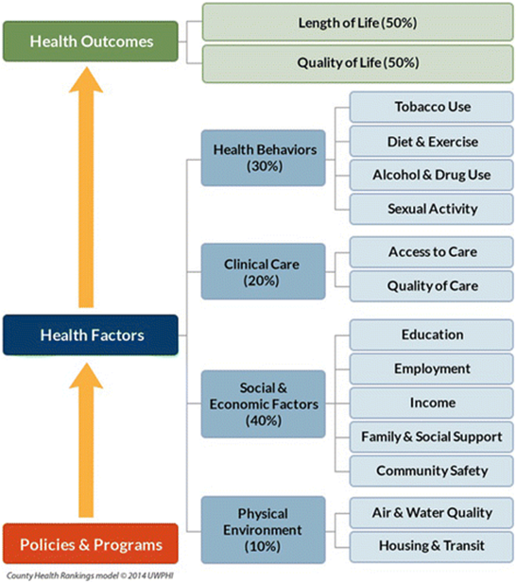
Our growing awareness of drivers of health…
Health is more than health care
Public health and clinical care have increased awareness and interest
NC’s population health goals for 2030 (Healthy North Carolina 2030) based on this framework

Slide 3
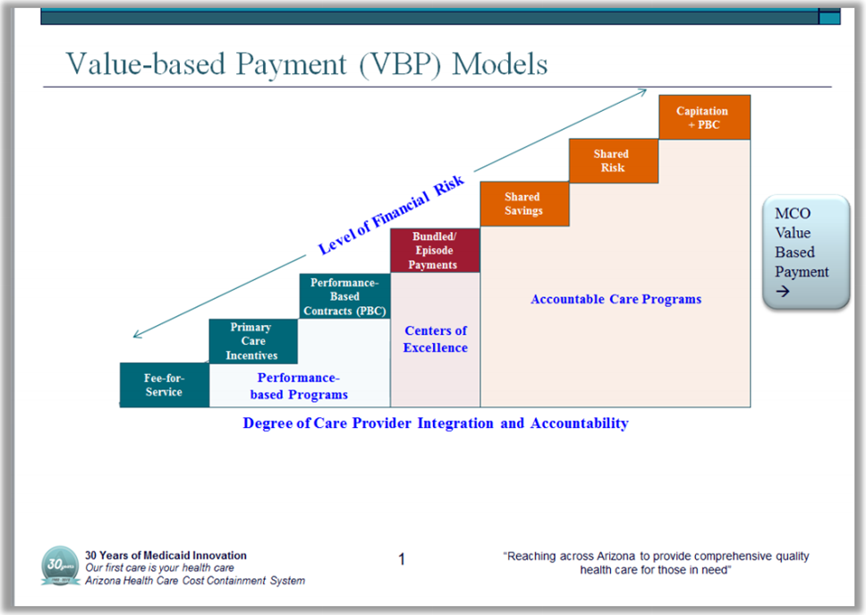
Paired with the growing movement to value-based care
30 Medicare Accountable Care Organizations
Medicaid reform
Blue Premier contracts with 5 health systems
Other private insurers (United, Cigna, Aetna)
What will it take to successfully address the many factors that impact a whole population’s health and well-being?

Slide 4
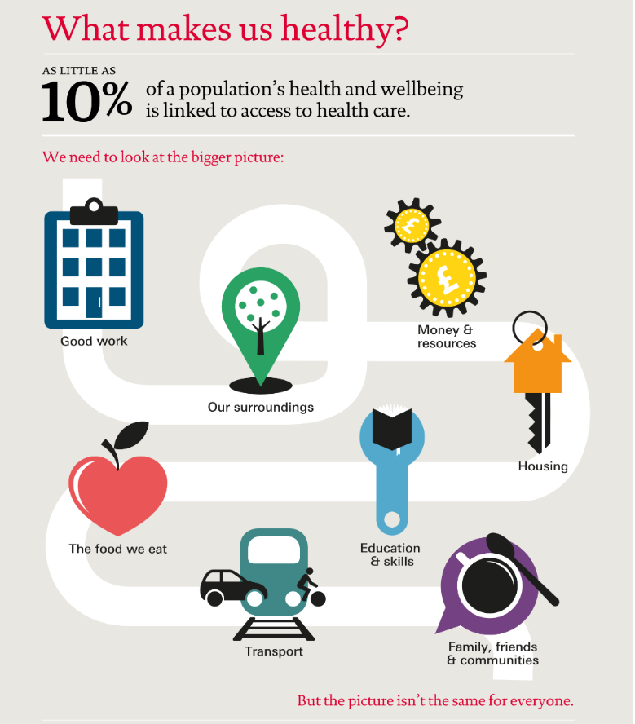
This work will require…
Working together in new ways
Making a positive impact on population health requires working together across existing boundaries and silos
Cannot be the efforts of only one sector (e.g., hospitals, payers, or public health)
MUST include community member input and participation
CHR Model: University of Wisconsin Population Health Institute. County Health Rankings & Roadmaps 2018. www.countyhealthrankings.org. Image used with permission of UWPHI
Notes:
Traditional health care and public health cannot do this alone, must partner with other sectors to positively impact all areas of people’s lives

Slide 5

Accountable Care Communities
Accountable Care Communities (ACCs) address health from a community perspective. ACCs bring together a coalition of cross-sector stakeholders that share responsibility to address the drivers of health while reducing, or holding steady, health spending.

Slide 6
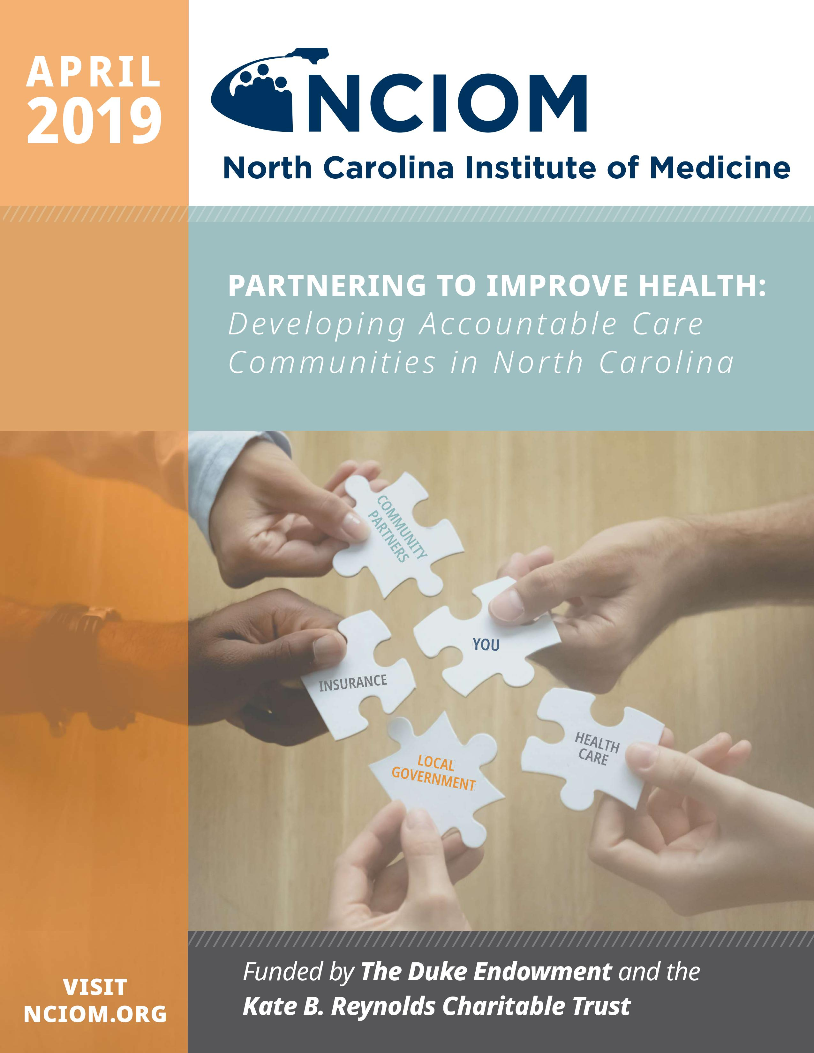
Task Force on Accountable Care Communities
Convened over 10 months in 2018
Co-Chairs: Secretary Mandy Cohen, Mr. Reuben Blackwell, Dr. Ron Paulus, Mayor Miles Atkins
Support from the Kate B. Reynolds Charitable Trust and The Duke Endowment
Produced:
24 Task Force recommendations to support development of ACCs
Guide for communities interested in developing an ACC

Slide 7
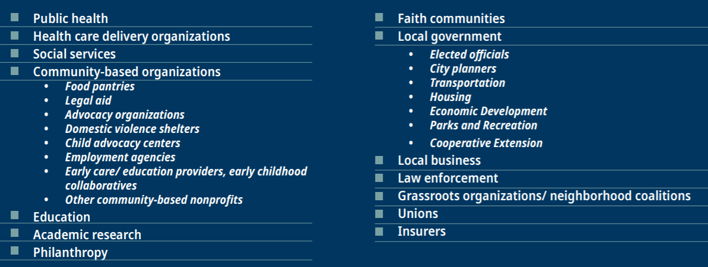
Cross-sector Partnerships to Address Barriers to Health
Accountable Care Community model brings together:
    Traditional health care with its focus on preventing and treating illness
    Community-based partners whose focus is on creating the conditions necessary for good health
    Those who purchase and pay for health care, among many other…

Slide 8
Core Features of Accountable Care Communities
Assessment of Community Health: analysis of community health issues to determine priorities
Education and Advocacy: a plan and mechanism to advance community health and health equity by advocating for local policies and communicating with local government agencies about the health effects of policy across sectors.
Screening Questions: a questionnaire to screen for health-related social needs.
Referral Process: protocols to refer clients for services that can help meet their needs.
Navigation Services: assistance for clients who have trouble accessing community services.

Slide 9
Core Features of Accountable Care Communities
Tracking System: ability to capture information about whether needs were met.
Outcomes Data and Analysis: data at the individual or population level tracking health outcomes (e.g., number of hospital visits; school days missed); and analysis of the data to determine what programs and services work and have positive return on investment.
Financing: analysis of return on investment can be used to develop financial models to support service delivery of both clinical and non-clinical services.
Governance: collaborative organizations in an ACC should have a shared governance structure that affords shared decision-making, shared risk, and shared reward.

Slide 10
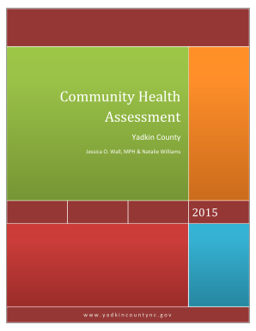
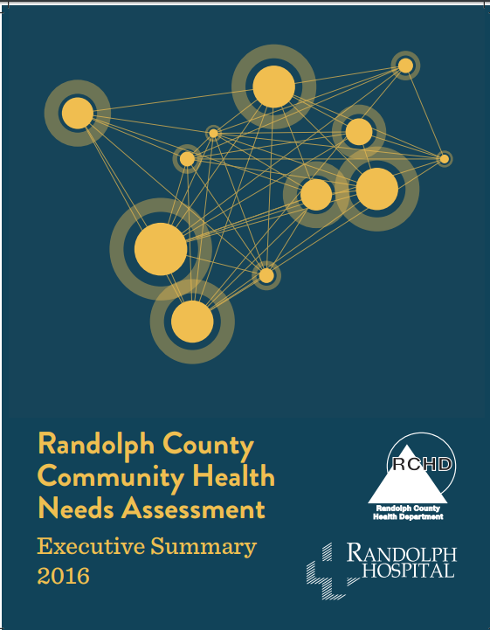
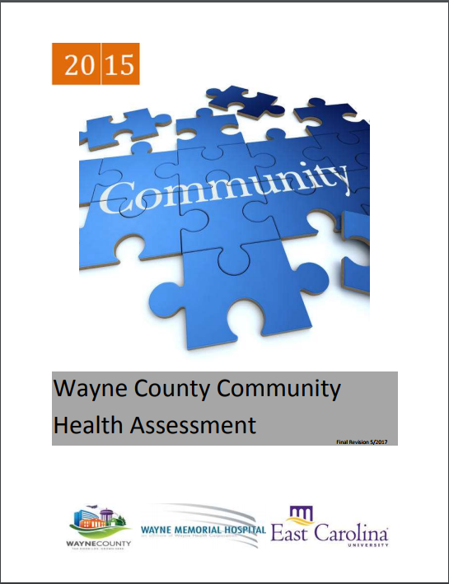
Assessment of Community Health
Community Health Assessments
  Conducted every 3-4 years by local health departments (LHD)
  Required as part of accreditation for LHDs
  Have been conducted in North Carolina for more than 40 years
  Assessment and improvement planning process

Slide 11

Education and Advocacy
Advancing community health and health equity by advocating for local policies and communicating with local government agencies about the health effects of policy across sectors.
Health in All Policies
  Promote health, equity, and sustainability
  Support intersectoral collaboration
  Benefit multiple partners
  Engage stakeholders
  Create structural or process change

Slide 12
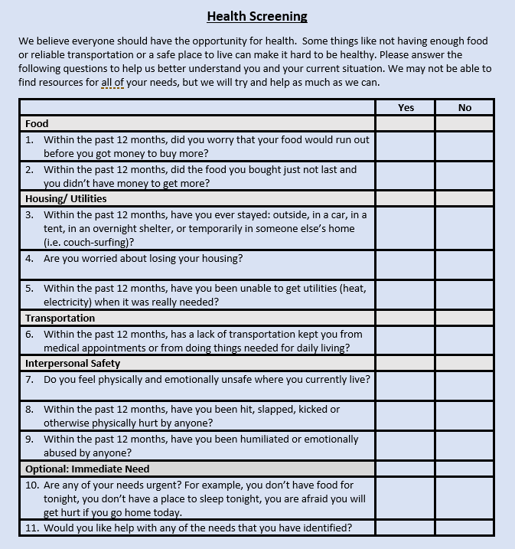
Screening Questions
NC DHHS Standardized Screening Questions
Medicaid Prepaid Health Plans will be required to use
NC DHHS encouraging statewide adoption
Questions in other domains also available from NC DHHS report from April 2018

Slide 13







Referral Process
NCCARE360 is the first statewide coordinated network that includes a robust data repository of shared resources and connects healthcare and human services providers together to collectively provide the opportunity for health to North Carolinians.
NCCARE360 Partners:
Notes:
One of the main provider objections to screening for health-related social needs is the lack of a plan for how to address identified needs.
Through a public-private partnership, NCCARE360, North Carolina is developing a common, shared system to help connect patients who screen positive for health-related social needs with community based services to meet those needs
This represents a massive endeavor to create a common good to improve the health and well-being of all North Carolinians

Slide 14
Navigation Services
Assistance for clients who have trouble accessing community services
Within Medicaid Prepaid Health Plans
  Prepaid Health Plans will receive per member per month payments that will support the implementation of screening, referral, navigation assistance
Many health systems and larger health care provider practices, as well as human service organizations, have care managers who may be able to meet some of the need for navigation services.

Slide 15

Tracking, Outcomes, Financing and Governance: Non-Medicaid
Will vary greatly across ACC models
  Hope that NC Health Connex will be able to fill the tracking and outcomes piece of this work to some degree.
  Outcomes measures are important for understanding effectiveness of efforts and for showing impacts of the work that can be used to negotiate for long-term funding and sustainability.

Slide 16

How Accountable Care Communities Fit into North Carolina’s Evolving Health Care System
NC DHHS has developed a framework for providing “Healthy Opportunities” to all North Carolinians that will build much of the infrastructure needed for accountable care communities
Healthy Opportunities Pilots

Slide 17
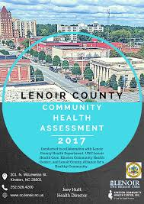
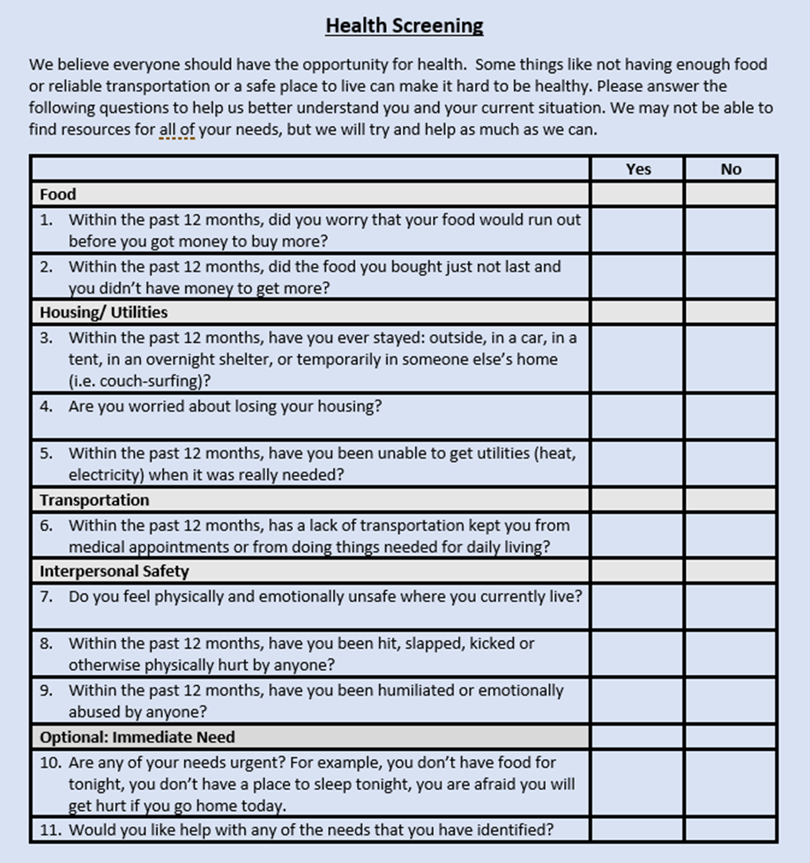
ACC Core Features Supported by NC DHHS
Community Health Assessments
Assessment of Community Health
Education and Advocacy
Screening Tool
Referral Process
Navigation Services
Tracking System
Outcomes Data and Analysis
Financing
Governance
Medicaid
Medicaid Managed Care core program element: Care Management
Medicaid
Medicaid
HIE and Medicaid Transformation Evaluation
Medicaid
Medicaid
Medicaid Managed Care- Regional Pilots

Slide 18




Accountable Care Community Example
DC PACT (Positive Accountable Community Transformation) is a coalition effort of community providers, including social service non-profits, faith institutions, behavioral health providers, hospitals, and community health centers, in partnership with multiple District government agencies including the Department of Health Care Finance, Department of Human Services, Department of Behavioral Health, and Department of Disability Services.
  DC Primary Care Association serves as the Collective Impact “backbone” organization, guided by an Advisory Council.
  DC PACT seeks to identify and address social challenges that create health disparities by linking safety net provider organizations in the District.

Slide 19
Any community can form an ACC
Existing groups that do similar work could choose to expand their mission to incorporate the goals of an ACC
  Roanoke Valley Community Health Initiative, joint effort of area businesses, child and family agencies, and community-based organizations
Local health departments are natural leaders
  Cabarrus Health Alliance
  US DHHS: local health department leaders should be Chief Health Strategists, partnering
    across multiple sectors
Community organizations could spearhead
  United Way, OIC, Housing Coalition, Ashe County Sharing Center
Health Systems
  Carolinas HealthCare System, Novant Health, and the Mecklenburg County Health Department partnering with community organizations, such as the YMCA of Greater Charlotte, Project 658, and the Renaissance West Community Initiative
Tribal governments and tribal communities
Start where you are!
Notes:
Roanoke Valley Community Health Initiative, joint effort of area businesses, child and family agencies, and community-based organizations dedicated to addressing healthy eating habits and physical activity opportunities in the community that will have a lasting impact on health outcomes
Carolinas HealthCare System, Novant Health, and the Mecklenburg County Health Department decided to collaborate and focus on the public health priority areas within Mecklenburg County, also partnering with community organizations, such as the YMCA of Greater Charlotte, Project 658, and the Renaissance West Community Initiative

Slide 20

Catalyzing Collaboration
Communities can unite around the concept of an ACC for a variety of reasons:
Response to health disparities
Increasing costs of care
Changing patient populations
Opportunities to collaborate on health assessments.

Slide 21
Natural Interests of Participating Partners
Community members – have an understanding of issues facing community and desire to have community voices directing actions taken
Local health departments - overall mission to improve community health and the specific charge to complete a Community Health Assessment
Health systems, hospitals, and other health care delivery organizations - ACCs seek to transform how health care is understood and delivered
Non-profit hospitals – must complete periodic community health needs assessment and spend some of their surplus on community needs
Human services organizations - uniquely positioned to serve as a bridge between communities and traditional health care organizations
Business – need healthy employees and control costs of health insurance
Other sectors (e.g., education, law enforcement, housing) – specific expertise and understanding of factors driving health & can benefit from better population health and well-being

Slide 22

Potential Barriers or Challenges
Distrust from community members based on historical injustices
Identifying champions/key leaders
Overburdened partners
Funding
Traditionally siloed interests
Agreement on priorities and strategies

Slide 23
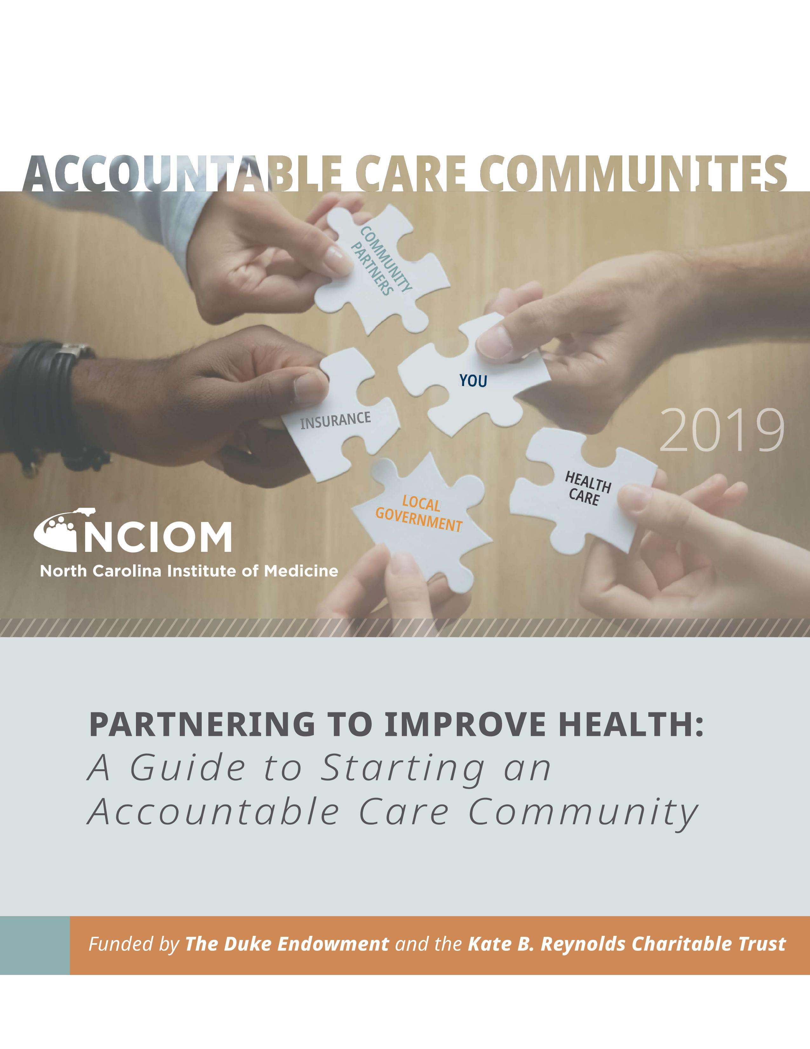
ACCs: A Guide to Getting Started
What is an ACC: core features and examples
Building partnerships and engaging community
Structure and governance
Financing and sustainability
Quick reference:
  Screening
  Referral
  Workforce
  IT infrastructure
  Legal considerations
  Assessment and evaluation
Lots of helpful resources!
http://nciom.org/nc-health-data/guide-to-accountable-care-communities/

Slide 24
Questions
Websites:
www.nciom.org
www.ncmedicaljournal.com
Contact:
Brieanne Lyda-McDonald, MSPH, Project Director, NCIOM
919-445-6154 or blydamcd@nciom.org

