Slide 1
Advancing HNC 2030 Through Community Partnerships: Introduction to the Accountable Care Community Model
Overview of Task Force Process and Charge
Berkeley Yorkery, MPP
Associate Director, NCIOM

Slide 2
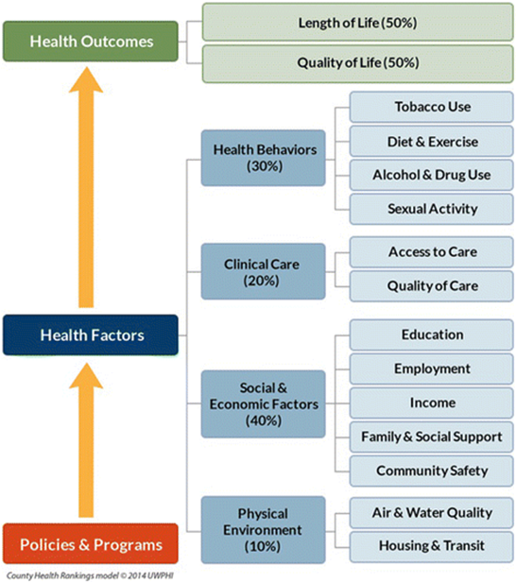
HNC 2030 AIM
To develop a common set of goals and objectives to mobilize and direct state and local efforts to improve the health and well-being of North Carolinians
What will it take to do this successfully?

Slide 3
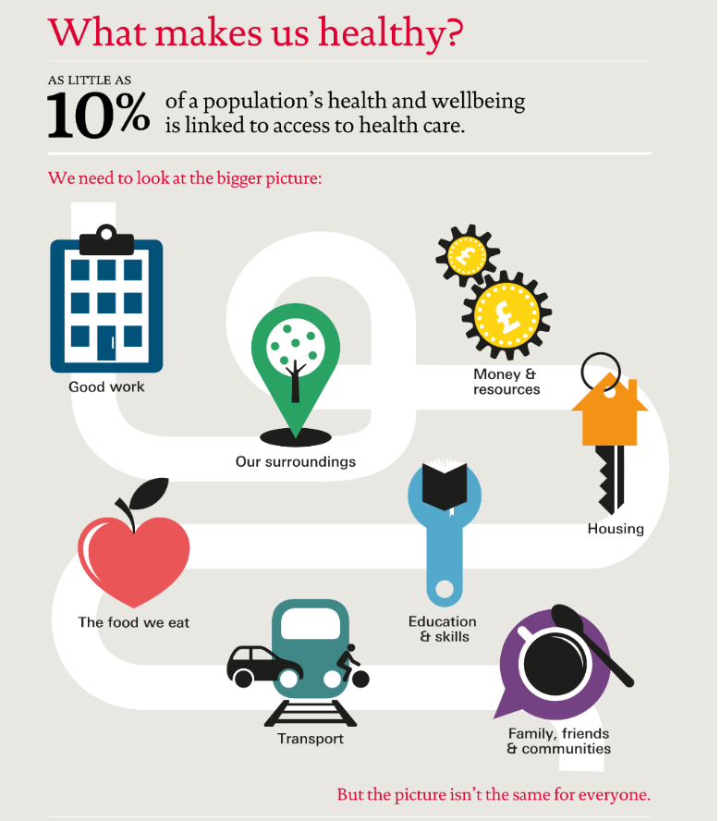
Achieving Targets will Require
Working together in new ways
Making a positive impact on health outcomes requires working together across existing boundaries
CHR Model: University of Wisconsin Population Health Institute. County Health Rankings & Roadmaps 2018. www.countyhealthrankings.org. Image used with permission of UWPHI
Notes:
Traditional health care and public health cannot do this alone, must partner with other sectors to positively impact all areas of people’s lives

Slide 4
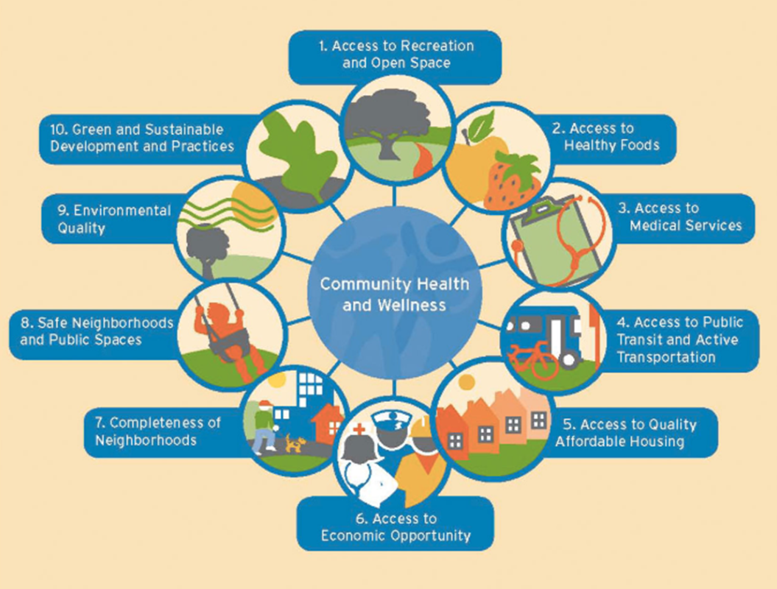
Cross-sector Partnerships to Address Barriers to Health
Accountable Care Community model:
bring together
traditional health care with its focus on preventing and treating illness,
community-based partners whose focus is on creating the conditions necessary for good health, and
those who purchase and pay for health care

Slide 5
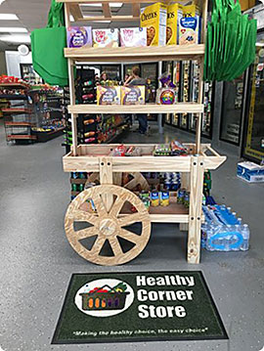
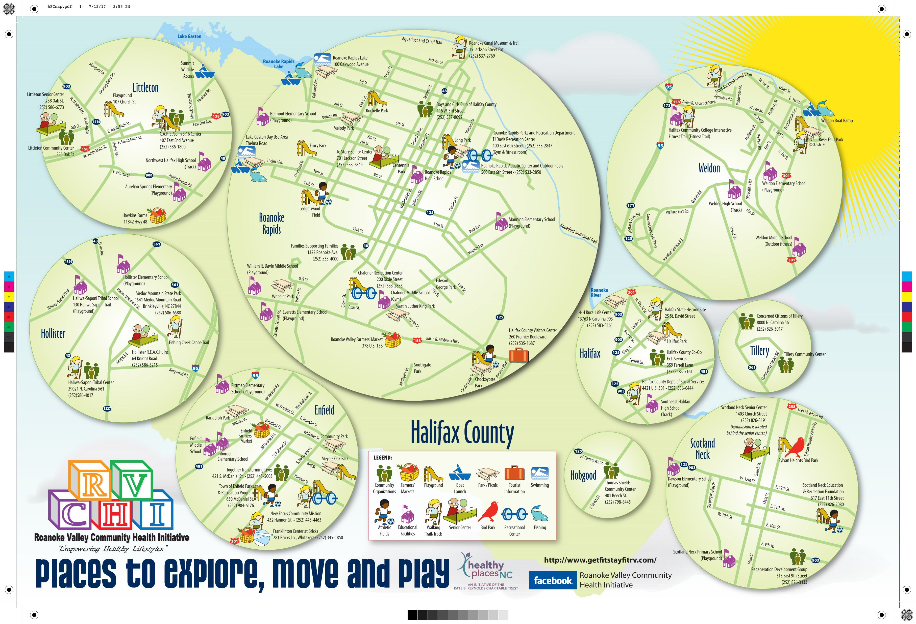
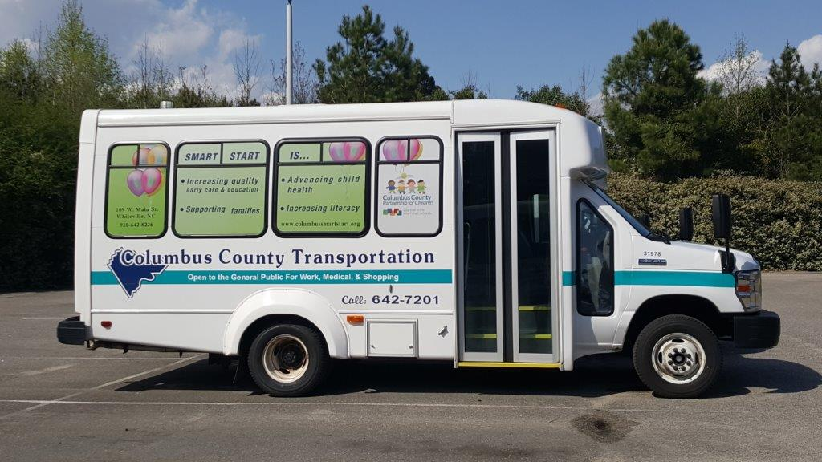
Accountable Care Communities
Accountable Care Communities (ACCs) address health from a community perspective. ACCs bring together a coalition of cross-sector stakeholders that share responsibility to address the drivers of health while reducing, or holding steady, health spending.

Slide 6
Examples of Accountable Care Communities
DC PACT (Positive Accountable Community Transformation) is a coalition effort of community providers, including social service non-profits, faith institutions, behavioral health providers, hospitals, and community health centers, in partnership with multiple District government agencies including the Department of Health Care Finance, Department of Human Services, Department of Behavioral Health, and Department of Disability Services.
DC Primary Care Association serves as the Collective Impact “backbone” organization, guided by an Advisory Council.
DC PACT seeks to identify and address social challenges that create health disparities by linking safety net provider organizations in the District.

Slide 7
Examples of Accountable Care Communities
CHA unified diverse organizations—from the local hospital system to county parks and recreation programs, school districts, and the Faith Community Health Ministry—to deliver environmental health services, clinical services, and community education to people who are considered to be at risk for developing preventable health conditions.
working in the domains of healthy behaviors and built environment to decrease both the percentage of adults who consume fewer than 5 servings of fruits and vegetables per day, and who report no exercise
working to increase the number of healthy corner stores, farmers markets accepting SNAP/EBT (Supplemental Nutrition Assistance Program/Electronic benefit transfer) benefits, facilities with joint use agreements, and physicians providing exercise prescriptions and referrals to local physical activity locations

Slide 8
Any community can form an ACC
Existing groups that do similar work could choose to expand their mission to incorporate the goals of an ACC
Roanoke Valley Community Health Initiative, joint effort of area businesses, child and family agencies, and community-based organizations dedicated to addressing healthy eating habits and physical activity opportunities in the community that will have a lasting impact on health outcomes
Local health departments are natural leaders
Cabarrus Health Alliance
US DHHS: local health department leaders should be Chief Health Strategists, partnering across multiple sectors
Community organizations could spearhead
United Way, OIC, Housing Coalition, Ashe County Sharing Center
Health Systems
Carolinas HealthCare System, Novant Health, and the Mecklenburg County Health Department decided to collaborate and focus on the public health priority areas within Mecklenburg County, also partnering with community organizaitons, such as the YMCA of Greater Charlotte, Project 658, and the Renaissance West Community Initiative

Slide 9
Any community can form an ACC
Potential Partners at the Table
Start where you are
Traditional health care
Local health departments
Health care systems and providers
Safety net providers
ACOs
Community-based partners
City and county government (Transportation, Parks and Rec, city council)
Local Education Agencies
Food banks, Area Agencies on Aging, Partnerships for Children,
Those who purchase and pay for health care
Insurers (private insurance, Medicaid Prepaid Health Plans)
Employers (including county and city governments)
ACOs
LME/MCOs
Ideally have all three buckets represented, but
Every ACC will not start with all the necessary partners
Any coalition can get ACC work started

Slide 10
Core Features of Accountable Care Communities
Assessment of Community Health: analysis of community health issues to determine priorities
Education and Advocacy: a plan and mechanism to advance community health and health equity by advocating for local policies and communicating with local government agencies about the health effects of policy across sectors.
Screening Tool: a questionnaire to screen for health-related social needs.
Referral Process: protocols to refer clients for services that can help meet their needs.
Navigation Services: assistance for clients who have trouble accessing community services.
Tracking System: ability to capture information about whether needs were met.
Outcomes Data and Analysis: data at the individual or population level tracking health outcomes (e.g., number of hospital visits; school days missed); and analysis of the data to determine what programs and services work and have positive return on investment.
Financing: analysis of return on investment can be used to develop financial models to support service delivery of both clinical and non-clinical services.
Governance: collaborative organizations in an ACC should have a shared governance structure that affords shared decision-making, shared risk, and shared reward.

Slide 11
How Accountable Care Communities Fit into North Carolina’s Evolving Health Care System
NC DHHS has developed a framework for providing “Healthy Opportunities” to all North Carolinians that will build much of the infrastructure needed for accountable care communities

Slide 12
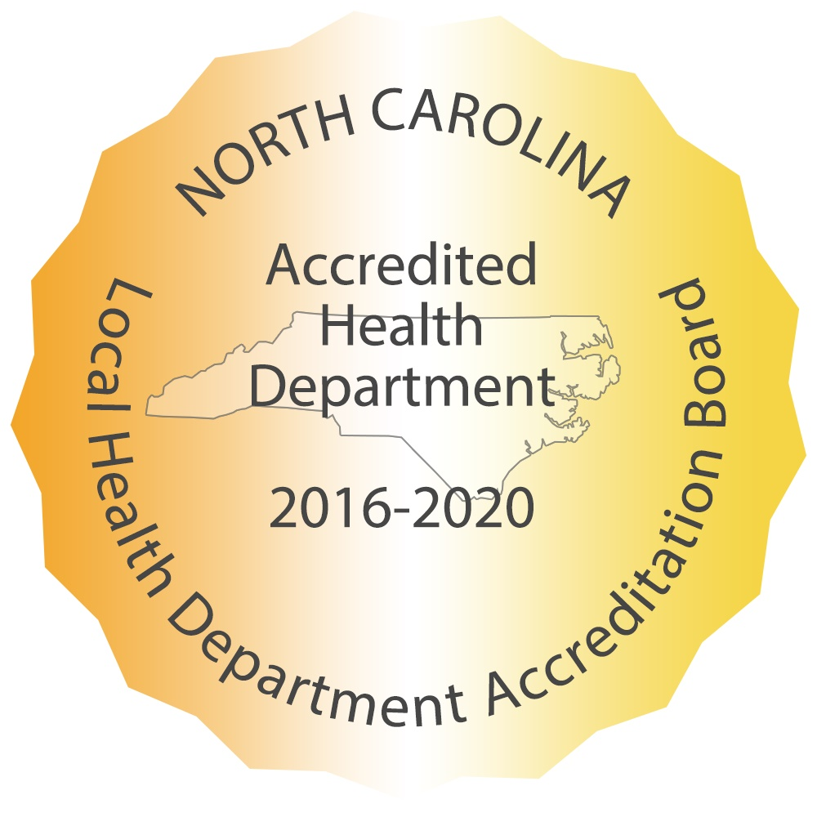
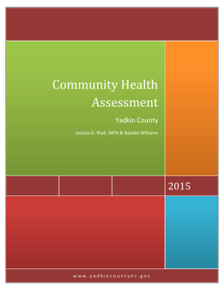
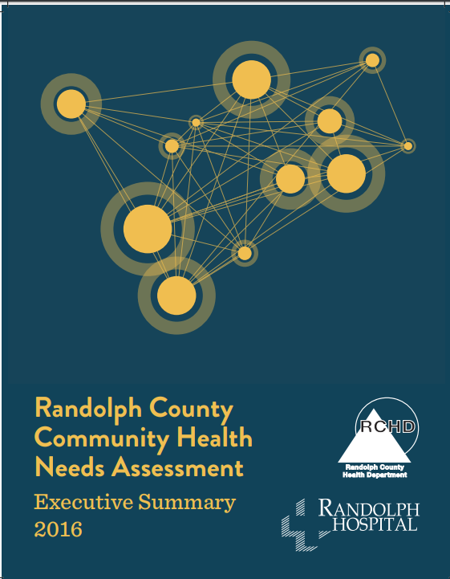
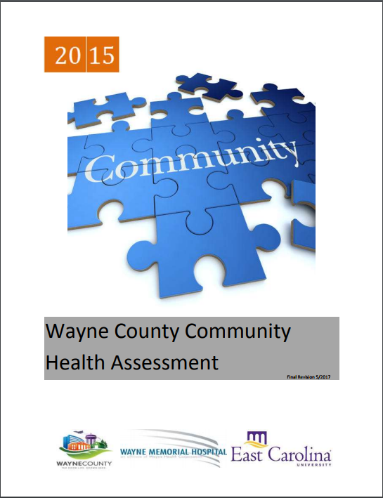
Assessment of Community Health
Community Health Assessments
Conducted every 3-4 years by local health departments (LHD)
Required as part of accreditation for LHD
Have been conducted in North Carolina for more than 40 years
Assessment and improvement planning process

Slide 13
Education and Advocacy
Plan and mechanism to advance community health and health equity by advocating for local policies and communicating with local government agencies about the health effects of policy across sectors.
Health in All Policies
Promote health, equity, and sustainability
Support intersectoral collaboration
Benefit multiple partners
Engage stakeholders
Create structural or process change

Slide 14
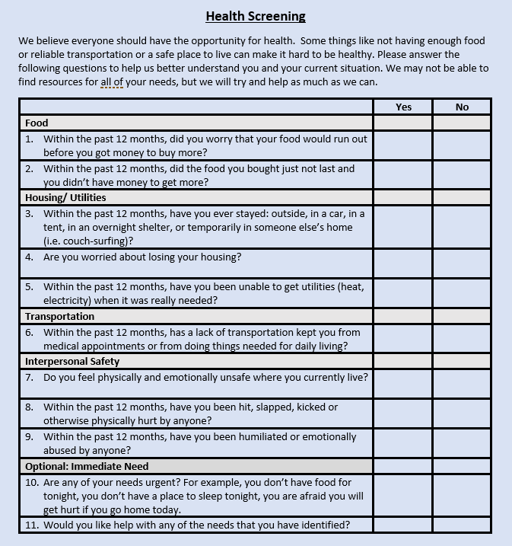
Screening Questions
NC DHHS Standardized Screening Questions
Medicaid Prepaid Health Plans will be required to use
NC DHHS encouraging statewide adoption

Slide 15
Referral Process
NCCARE360 is the first statewide coordinated network that includes a robust data repository of shared resources and connects healthcare and human services providers together to collectively provide the opportunity for health to North Carolinians.
NCCARE360 Partners:
Notes:
One of the main provider objections to screening for health-related social needs is the lack of a plan for how to address identified needs.
Through a public-private partnership, NCCARE360, North Carolina is developing a common, shared system to help connect patients who screen positive for health-related social needs with community based services to meet those needs
This represents a massive endeavor to create a common good to improve the health and well-being of all North Carolinians

Slide 16
Navigation Services
Assistance for clients who have trouble accessing community services
Within Medicaid Prepaid Health Plans
Prepaid Health Plans will receive per member per month payments that will support the implementation of screening, referral, navigation assistance
Many health systems and larger health care provider practices, as well as human service organizations, have care managers who may be able to meet some of the need for navigation services.

Slide 17
Tracking, Outcomes, Financing and Governance: Non-Medicaid
Tracking, outcome measurement, financing and governance will vary greatly across ACC models
Hope that NC Health Connex will be able to fill the tracking and outcomes piece of this work to some degree.

Slide 18
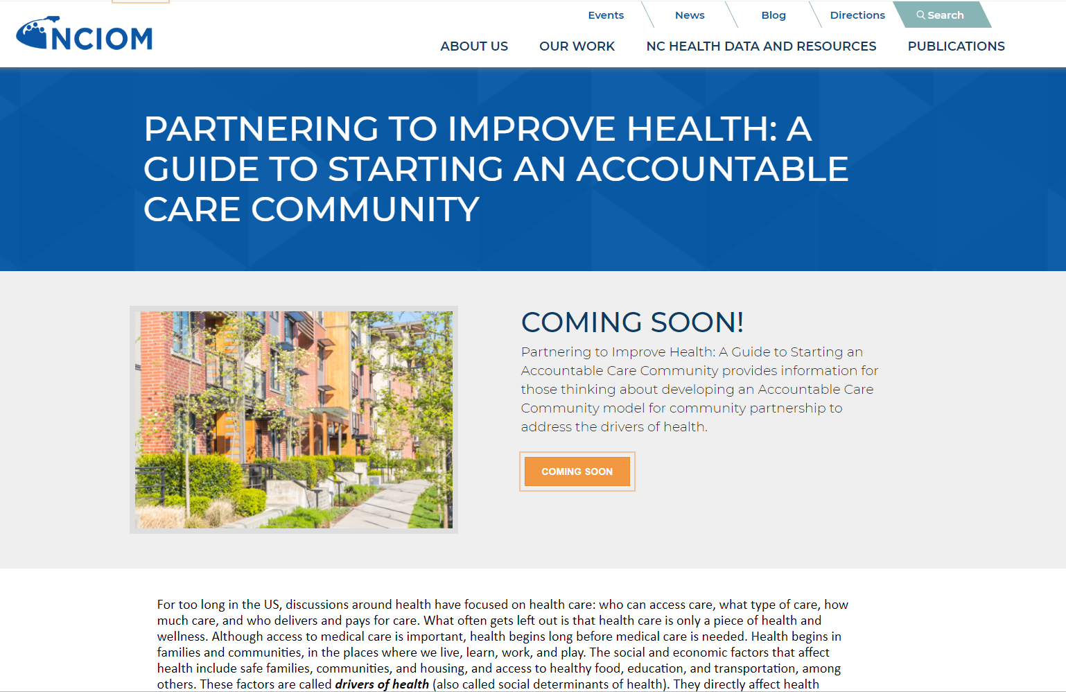
ACCs: A Guide to Getting Started
http://nciom.org/nc-health-data/guide-to-accountable-care-communities/

Slide 19
Tracking, Outcomes, Financing and Governance: Medicaid
Under Medicaid Transformation, NC DHHS will track:
Health and health-related service receipt
Costs
Standardized screening tool data
Measure outcomes
Within the Healthy Opportunities pilots, will also:
Experiment with new payment models
Develop a governance structure at the local level

Slide 20
Healthy Opportunities Regional Pilots
Sample Regional Pilot
Pilot Overview
Authorization to spend up to $650 million in 2-4 regions
Test and scale to a population level evidence-based interventions designed to improve health and reduce costs more intensely addressing food insecurity, housing quality and instability, transportation insecurity, interpersonal violence and toxic stress
For eligible Medicaid beneficiaries (health and social risk)
Key pilot entities include:
North Carolina DHHS
Prepaid Health Plans (PHPs)
Care Managers (predominantly located at Tier 3 AMHs and LHDs)
Lead Pilot Entities
Human Service Organizations (HSOs)
NCCARE360 part of the infrastructure
North Carolina
Prepaid Health Plan
Prepaid Health Plan
Prepaid Health Plan
Care Managers
Care Managers
Care Managers
NCCARE3
6
0
Lead Pilot Entity
Human Service Organizations (HSOs)
HSO
HSO
HSO
Notes:
Discuss who is included in Medicaid Transformation and who is not

Slide 21
Overview of Approved Pilot Services
North Carolina’s 1115 waiver specifies services that can be covered by the Pilot. Pilots will not be required to offer all approved services.
Housing
Tenancy support and sustaining services
Housing quality and safety improvements
One-time securing house payments (e.g., first month’s rent and security deposit)
Short-term post hospitalization housing
Transportation
Linkages to existing public transit
Payment for transit to support access to pilot services, including:
Public transit
Taxis, in areas with limited public transit infrastructure
Interpersonal Violence
Linkages to legal services for IPV related issues
Evidence-based parenting support programs
Evidence-based home visiting services
Food
Linkages to community-based food services (e.g., SNAP/WIC application support, food bank referrals)
Nutrition and cooking coaching/counseling
Healthy food boxes
Medically tailored meal delivery

Slide 22
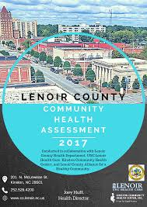
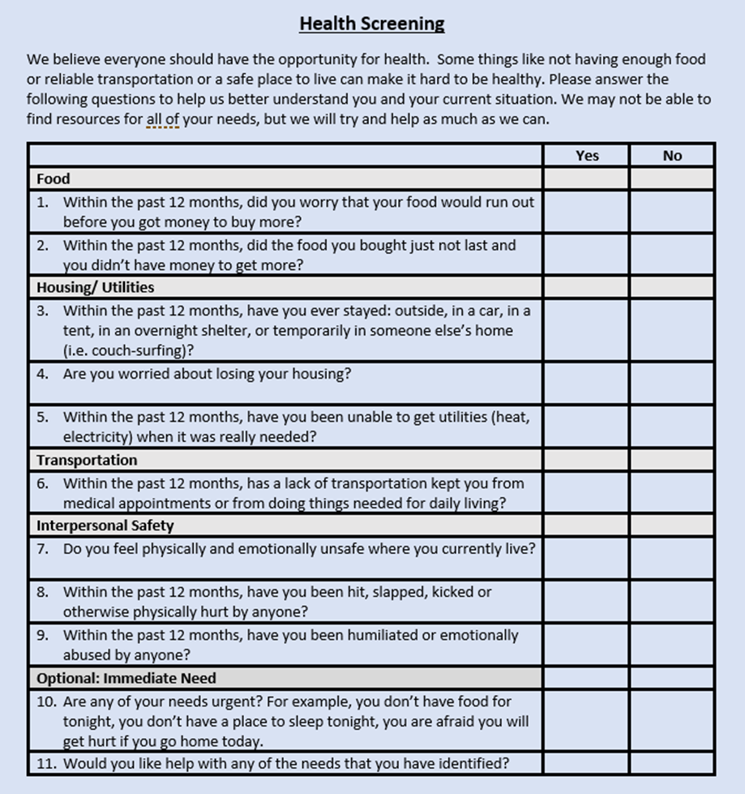
ACC Core Features Supported by NC DHHS
Assessment of Community Health
Education and Advocacy
Screening Tool
Referral Process
Navigation Services
Tracking System
Outcomes Data and Analysis
Financing
Governance
Community Health Assessments
Medicaid
Medicaid
Medicaid Managed Care core program element: Care Management
Medicaid
Medicaid
HIE and Medicaid Transformation Evaluation
Medicaid
Medicaid Managed Care- Regional Pilots

Slide 23
ACCs: A Guide to Getting Started
www.nciom.org/nc-health-data/guide-to-accountable-care-communities/

Slide 24
ACCs: A Guide to Getting Started
What is an ACC: core features and examples
Building partnerships and engaging community
Structure and governance
Financing and sustainability
Quick reference:
Screening
Referral
Workforce
IT infrastructure
Legal considerations
Assessment and evaluation
Lots of helpful resources!

