Slide 1
Healthy North Carolina 2030 Community Input Session
Welcome!
Help yourself to food.
Wifi –
Bathrooms -

Slide 2


Healthy North Carolina 2030
Community Input Sessions
Brieanne Lyda-McDonald, MSPH
Project Director
North Carolina Institute of Medicine

Slide 3
NC Institute of Medicine
Quasi-state agency chartered in 1983 by the NC General Assembly to:
  Be concerned with the health of the people of North Carolina
  Monitor and study health matters
  Respond authoritatively when found advisable
  Respond to requests from outside sources for analysis and advice when this will aid in forming a basis for health policy decisions
  NCGS §90-470

Slide 4

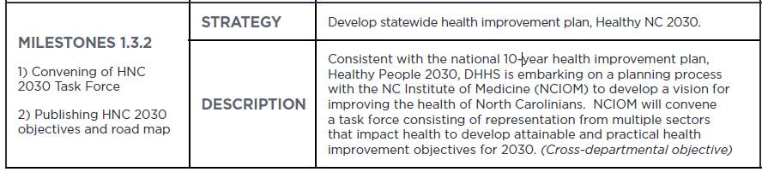
NCIOM Studies
NCIOM studies issues at the request of the General Assembly, state agencies, health professional organizations, & NCIOM Board of Directors
Often work in partnership with other organizations to study health issues
  HNC 2030 is in partnership with NC Division of Public Health

Slide 5

Aim of Healthy North Carolina
To develop a common set of goals and objectives to mobilize and direct state and local efforts to improve the health and well-being of North Carolinians.

Slide 6
How will HNC 2030 be used?
Common set of public health indicators and targets for the state over the next decade
  Population health improvement plan for the North Carolina Division of Public Health
Help drive state and local-level activities
Provide a springboard for collaboration and innovation

Slide 7


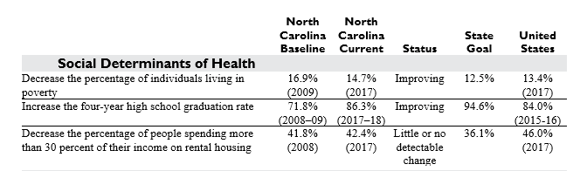
Health Indicators and Targets
Health Indicators – measurable characteristics that describe the health or drivers of health of a population
Targets – goals for improving the health indicators over the next 10 years

Slide 8

Healthy North Carolina 2020: 10-Year Outcomes
41 indicators:
  Met the targets: 5 (12%)
    HIV diagnoses, traffic crashes, child dental services
  Made progress: 12 (29%)
    Adult smoking, healthy eating, graduation rate
  Stayed the same/no progress: 18 (44%)
    Youth tobacco use, physical activity, housing cost
  Got worse: 6 (15%)
    Infant mortality disparity, suicide, unintentional poisoning

Slide 9
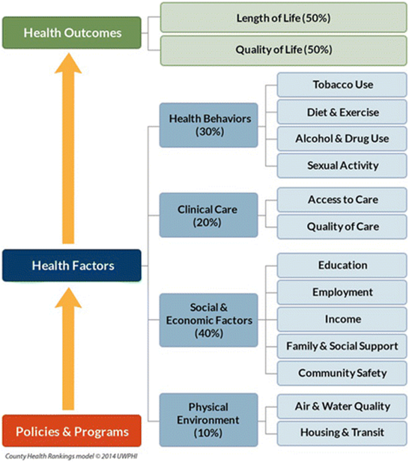
Healthy North Carolina 2030:
Framework and Organization
Develop 20 indicators
Healthy North Carolina 2030 Task Force
  Select the Health Outcomes indicators and review other indicators selected by work groups
Healthy North Carolina 2030 Work Groups
  Work groups for each topic area will select indicators in those topics
Healthy North Carolina 2030 Community Input Sessions
  Meetings held February-April of 2018

Slide 10
Healthy North Carolina 2030 Task Force Timeline
January 2019: 1st Task Force Meeting
February: Work Groups - 1st Meeting
  Narrow set of potential indicators for each topic
February-April: Community Input Sessions
  Rank indicators for each topic
March: 2nd Task Force Meeting
  Select 3 health outcome indicators
May: Work Groups - 2nd Meeting
  Use community input to recommend final indicators
June: 3rd Task Force Meeting
  Set targets for 3 health outcome indicators
  Review list of indicators recommended by Work Groups
July: Work Groups - 3rd Meeting
  Set targets for selected indicators
August: 4th Task Force Meeting
  Review all indicators and HNC 2030 report text
January 2020: Present HNC 2030 at North Carolina Public
Health Leaders' Conference
Community input goes to the work groups and task force for consideration and final indicator selection.

Slide 11
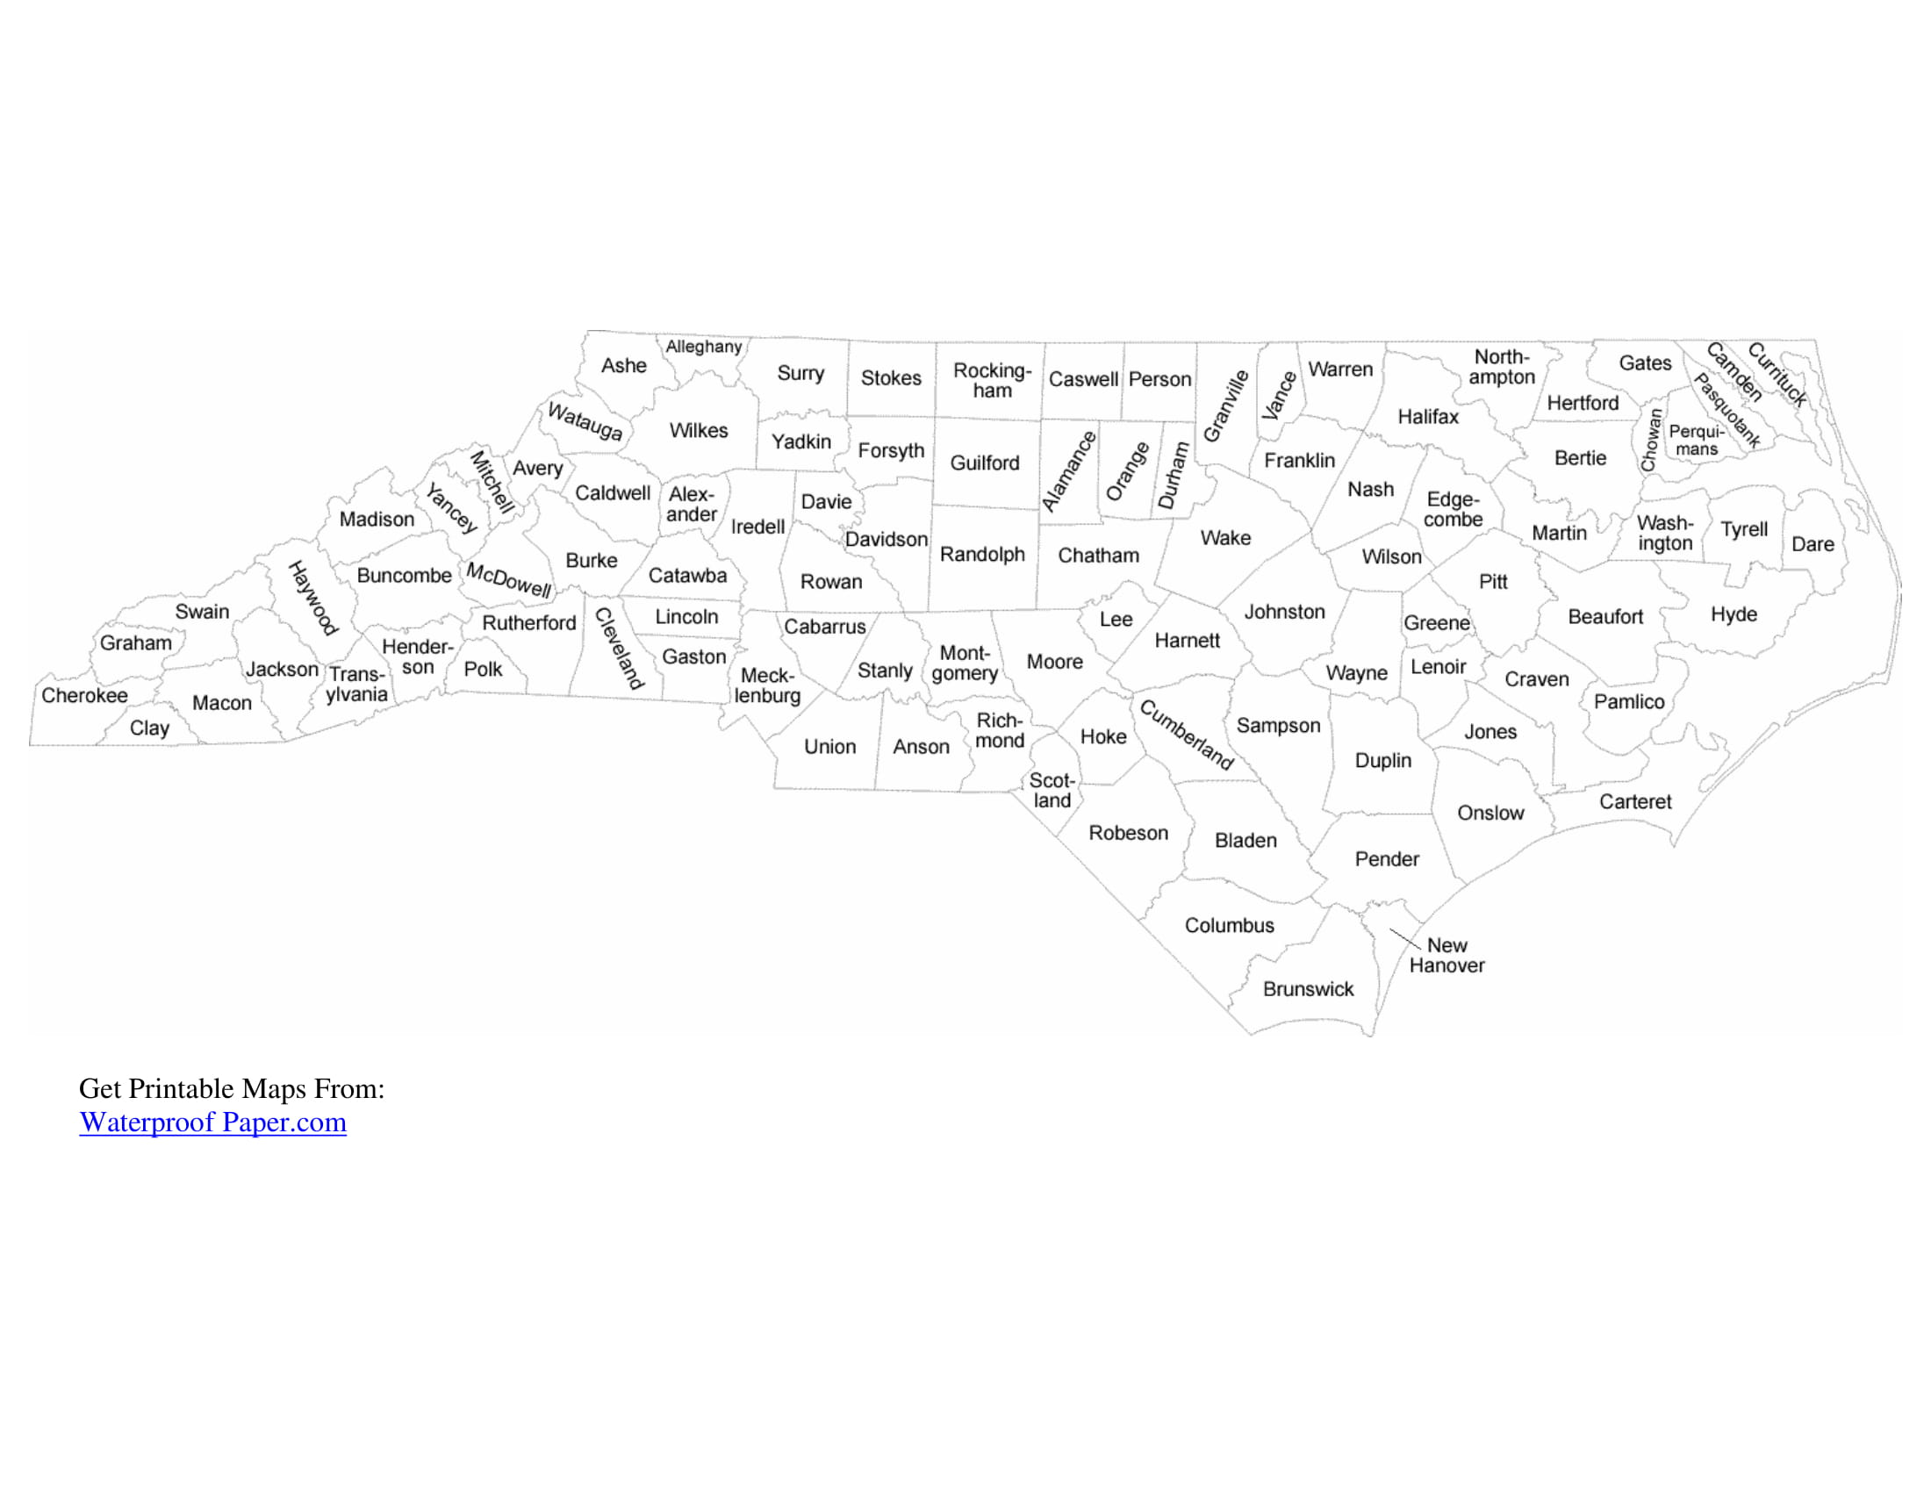

HNC 2030 Community Input Sessions
GTCC – East Campus
April 3rd, 5:00-7:30pm
Perry Memorial Library
Henderson, NC
March 5th, 5:00-7:30pm
Eastern AHEC
Health ENC meeting
February 27th, 12:45-3:15pm
Marion Senior Center
April 9th, 1:30-4:00pm
Cherokee Indian Hospital
April 9th, 8:00-10:00am
Charlotte – Goodwill Opportunity Campus
April 3rd from 11:30-2:00pm
Coastal Carolina Community College
March 19th, 12:00-2:30pm
UNC Pembroke
March 6th, 12:00-2:30pm

Slide 12

HNC 2030 Task Force Vision
Important driving principles:
  Health equity (the opportunity for everyone to have good health) – consider for indicator AND target selection
  Eliminate disparities (measurable differences or gaps seen in one group’s health status in relation to another or other group(s)) – consider for target selection
  We want a state/communities/children/adults that is/are:
    Healthy
    Safe
    Resilient
    Empowered
    Inclusive
    Equitably connected to resources
    Given opportunities to grow, play, succeed
    Actively working to eliminate disparities in health outcomes
    That we can be proud of
    For ALL people in our borders

Slide 13
Healthy North Carolina 2030: Indicators
Indicators should be:
  Measurable
  Useful and understandable to a broad audience
  Address a range of issues
  Prevention-oriented
  Address health inequities
  Available at county level
  Measured every three years
Developmental measures - if indicators of interest, but there is not good quality data for the state
Localities, non-governmental organizations, tribal governments and public/private sectors should be able to use indicators to direct efforts in schools, communities, worksites, health care practices, and other environments.

Slide 14

Indicator Development
Work groups started from lists of indicators from:
  Various state health improvement plans
  NC DHHS Healthy Opportunities Framework
  America’s Health Rankings
  US Healthy People 2030
  Member recommendations
Indicators are measures that already exist.
They are defined by the survey or data source they come from.

Slide 15
Indicator Limitations
Indicators we are discussing represent best available measures for topics
Examples of indicators that aren’t available:
  Safe sex practices
    We have unintended pregnancy, teen birth rate
  Sexually Transmitted Disease (STD) prevalence
    We have HIV, chlamydia, gonorrhea, syphilis
  Adult nicotine use
    We have adult smoking
  Healthy eating
    We have veg. one or more times per day
  Adult oral health visit
    We have tooth removal/tooth decay

Slide 16


Why are you here?
Community input on narrowed list of indicators
What is important to YOU and YOUR COMMUNITY?
Are we missing a topic that is important?
Input will go back to work groups and task force for final consideration of indicator selection

Slide 17

Small Group Discussion
  Materials in front of you
  4 discussion periods for each topic area:
    Physical Environment
    Health Behavior
    Clinical Care
    Social & Economic Factors
  For each discussion period:
    5 minutes individual review and ranking
    Small group discussion to determine top 3 priority for that topic
    Check-in at 10 minutes to see group status
    Mini poll after each topic

Slide 18
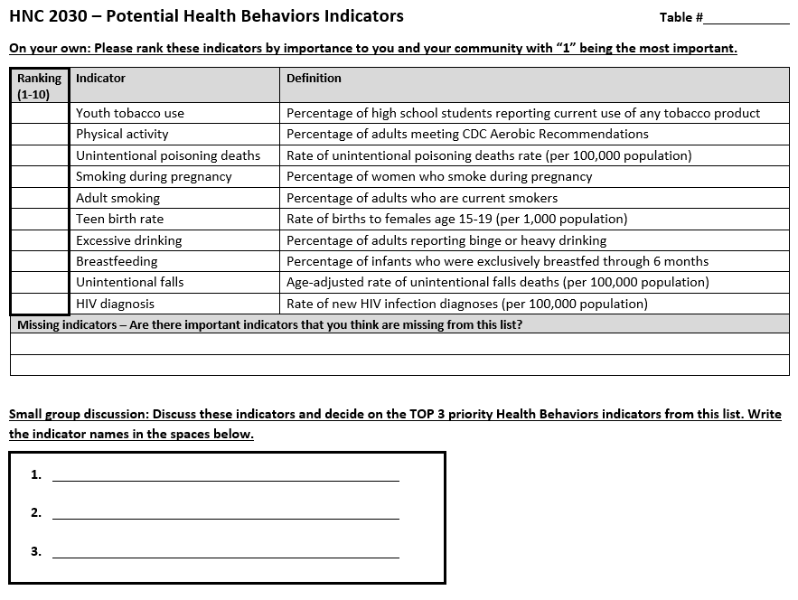
Health Behavior
Small Group Discussion
5 min.
20 min.

Slide 19
Health Behavior
Small Group Discussion
5 Health Behavior indicators will be included on the final list of 20 for HNC 2030

Slide 20

Health Behavior
Small Group Discussion
Aspects of Health Behaviors:
Alcohol and Drug Use - When consumed in excess, alcohol is harmful to the health and well-being of those that drink as well as their families, friends, and communities. Prescription drug misuse and illicit drug use also have substantial health, economic, and social consequences.
Diet and Exercise – The foods we consume and the amount of physical activity we engage in, along with genetic factors and personal choices, shape our health and our risk of being overweight and obese.
Sexual Activity - Sexually transmitted infections and unplanned pregnancies have lasting effects on health and well-being, especially for adolescents.
Tobacco Use - Tobacco use is the leading cause of preventable death in the United States.
Other – e.g., Falls and Breastfeeding

Slide 21
Health Behavior FAQ
Some indicators are not “behaviors” – using closest possible measure (ex. teen birth rate & HIV diagnosis)
Youth tobacco use includes e-cigarettes
“Missing” indicators:
  Adult nicotine use – measures of adult smoking do not account for vaping/e-cigarette use; we do not have a measure that would show this data
  Healthy eating – available measures of veg and fruit intake “one or more times per day”

Slide 22
Health Behavior
Small Group Discussion
5 min.
20 min.

Slide 23
Questions about process
Any questions before moving on?

Slide 24
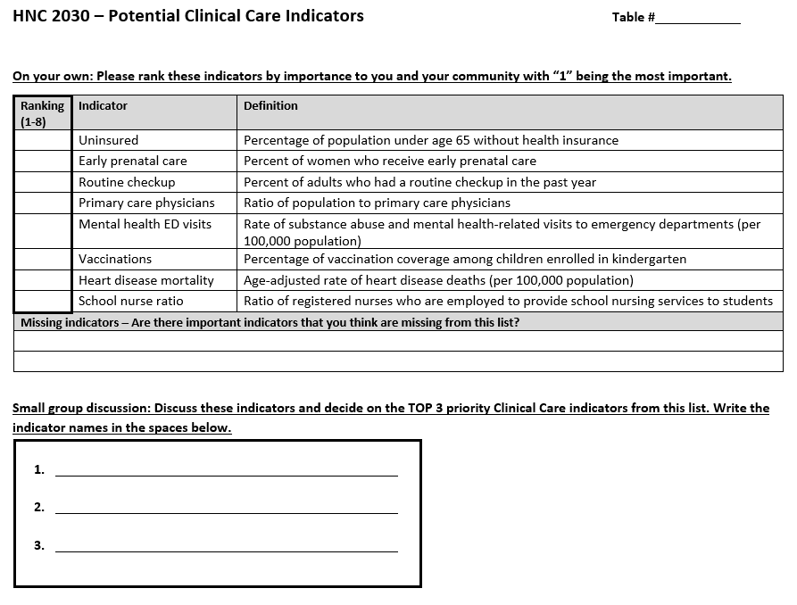
Clinical Care
Small Group Discussion
5 min.
15 min.

Slide 25
Clinical Care
Small Group Discussion
4 Clinical Care indicators will be included on the final list of 20 for HNC 2030

Slide 26
Clinical Care
Small Group Discussion
Aspects of Clinical Care:
Access to Care - Access to affordable, quality health care is important to physical, social, and mental health.
Quality of Care - High quality health care is timely, safe, effective, and affordable–the right care for the right person at the right time.

Slide 27
Clinical Care FAQs
Heart disease & Mental health ED visits
  Measures related to access/quality of care
Primary care PROVIDERS vs. Physicians
  Not included in your list of indicators - Ratio of population to primary care providers other than physicians
  Different data sources cannot be combined

Slide 28
Clinical Care
Small Group Discussion
5 min.
15 min.

Slide 29
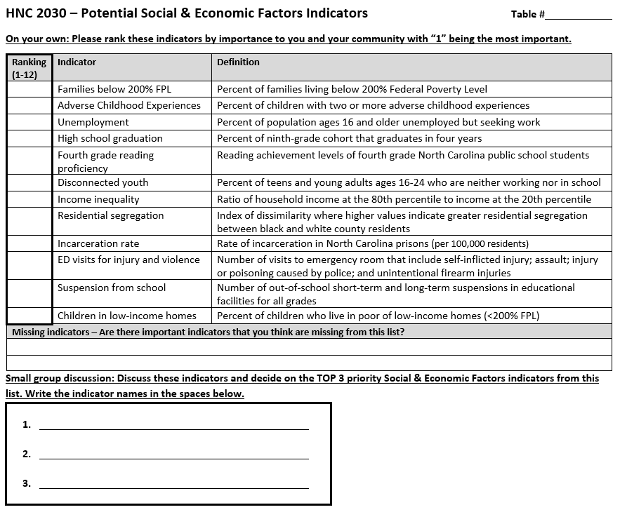
Social & Economic Factors
Small Group Discussion
5 min.
20 min.

Slide 30
Social & Economic Factors
Small Group Discussion
6 Social & Economic Factor indicators will be included on the final list of 20 for HNC 2030

Slide 31
Social & Economic Factors
Small Group Discussion
Aspects of Social & Economic Factors:
Community Safety - Injuries through accidents or violence are the third leading cause of death in the United States, and the leading cause for those between the ages of one and 44.
Education - Better educated individuals live longer, healthier lives than those with less education, and their children are more likely to thrive.
Employment - Employment provides income and, often, benefits that can support healthy lifestyle choices. Unemployment and under employment limit these choices, and negatively affect both quality of life and health overall.
Family and Social Support - People with greater social support, less isolation, and greater interpersonal trust live longer and healthier lives than those who are socially isolated.
Income - Income provides economic resources that shape choices about housing, education, child care, food, medical care, and more.

Slide 32
Social & Economic Factor FAQs
Income inequality – extent to which income is unevenly distributed among the population
Families below 200% FPL vs. Children in low-income homes
Disconnected youth – measure of how young people are faring with transition to adulthood; “disconnected” because cut off from institutions where they would develop knowledge, skills, maturity, & sense of purpose

Slide 33
Social & Economic Factors
Small Group Discussion
5 min.
20 min.

Slide 34
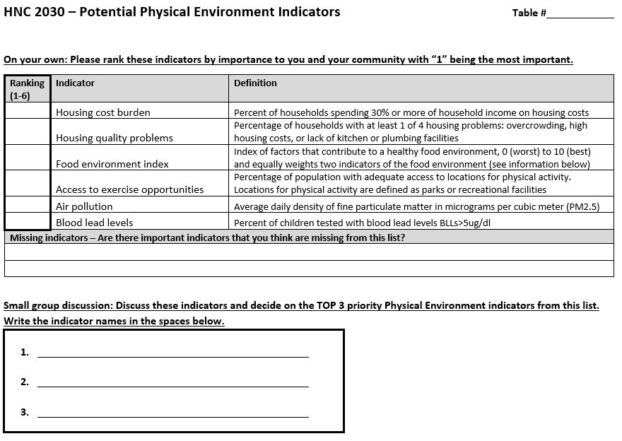
Physical Environment
Small Group Discussion
5 min.
15 min.

Slide 35
Physical Environment
Small Group Discussion
2 Physical Environment indicators will be included on the final list of 20 for HNC 2030

Slide 36
Physical Environment
Small Group Discussion
Aspects of Physical Environment:
Air and Water Quality
  Clean air and safe water are prerequisites for health.
Housing and Transit
  The housing options and transit systems that shape our communities’ built environment affect where we live and how we get from place to place.
Other
  Access to healthy foods and exercise opportunities

Slide 37
Physical Environment FAQs
Transportation – challenge identifying measures that have data available and are applicable across state (rural/urban)

Slide 38
Physical Environment
Small Group Discussion
5 min.
15 min.

Slide 39
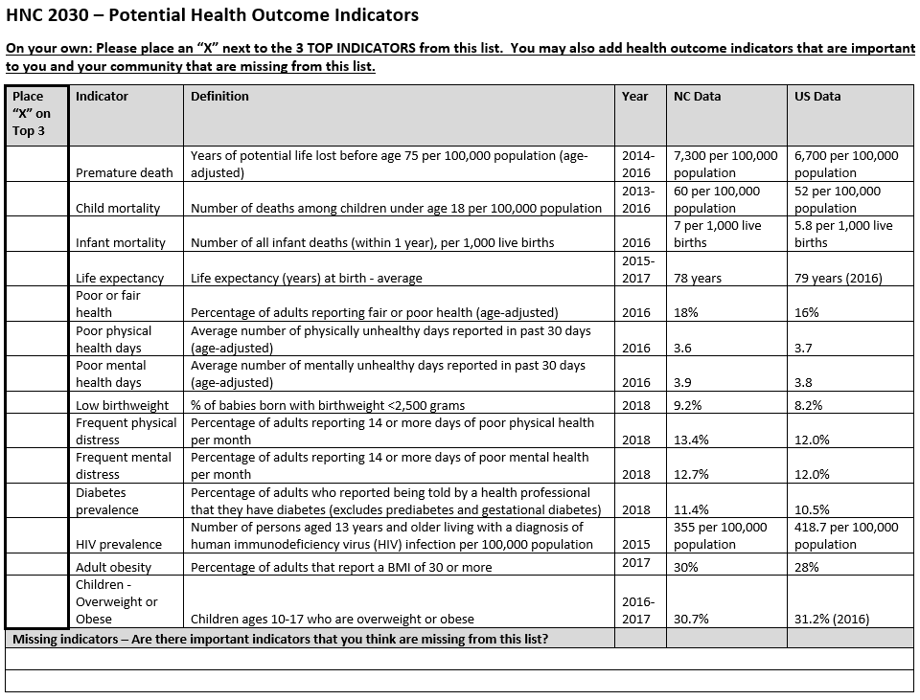
Health Outcomes
Individual Ranking
5 min.

Slide 40
Next Steps
Community feedback summary will be sent to attendees electronically.
Community input will be given to work group members, who will finalize selection and set targets for each indicator.
Overall task force will review and finalize.
NCIOM staff will develop a report, which will be distributed widely, and presented at future meetings of stakeholders.

Slide 41
For More Information
Support for this Task Force comes from the Blue Cross and Blue Shield Foundation of North Carolina, The Duke Endowment, and the Kate B. Reynolds Charitable Trust
Websites: www.nciom.org
www.ncmedicaljournal.com
Key Contacts:
  Brieanne Lyda-McDonald, MSPH, Project Director, NCIOM 919-445-6154 or blydamcd@nciom.org
  Chloe Donohoe, Research Assistant, NCIOM 919-445-6156 or chloe_donohoe@nciom.org

